Slide 1


Use GP Macros to simplify repetitive tasks
San Antonio, Texas
October 13-17, 2024

Slide 2

John Arnold
Senior Software Engineer for US Digital – Vancouver, WA
Geek/nerd for many years (decades) who still loves all forms of programming (C#, SQL...)
Dedicated family man who loves his family, woodworking, Lego, puzzles, and Mtn Dew
Born and raised in Pittsburgh but now
calls the PNW home
Slide Deck Version 1.0

Slide 3
Session Agenda
What is a macro?
Creating and running macros
Editing macros – Notepad++ (GP Macro xml file for color coding)
Replicator vs Mail Merge
Replicator Example: Inactivate Inventory Items

Slide 4
What is a macro
A series of commands/instructions
Tells a program what to do or how to run
Unique per program
  Word/Excel (VBA)
  SolidWorks (VBA)
  GP (Dexterity)

Slide 5
Macros in GP
To Record
  Dynamics GP -> Tools -> Macro -> Record from main window
  Tools -> Macro -> Record from child window
  Alt + F8 - Record from anywhere (even the login window)
To Play
  Dynamics GP -> Tools -> Macro -> Play from main window
  Tools -> Macro -> Play from child window
  Ctrl + F8 – Play back a macro from anywhere
Important: Play the macro from
where it was recorded

Slide 6
Basic Macro Example
Record macro to open the Item Maintenance window
Look at this Macro's details
Remove unnecessary lines
Hide the "Macro ran" dialog
Assign Keyboard Shortcut to a macro
Assign Macro to Startup folder

Slide 7
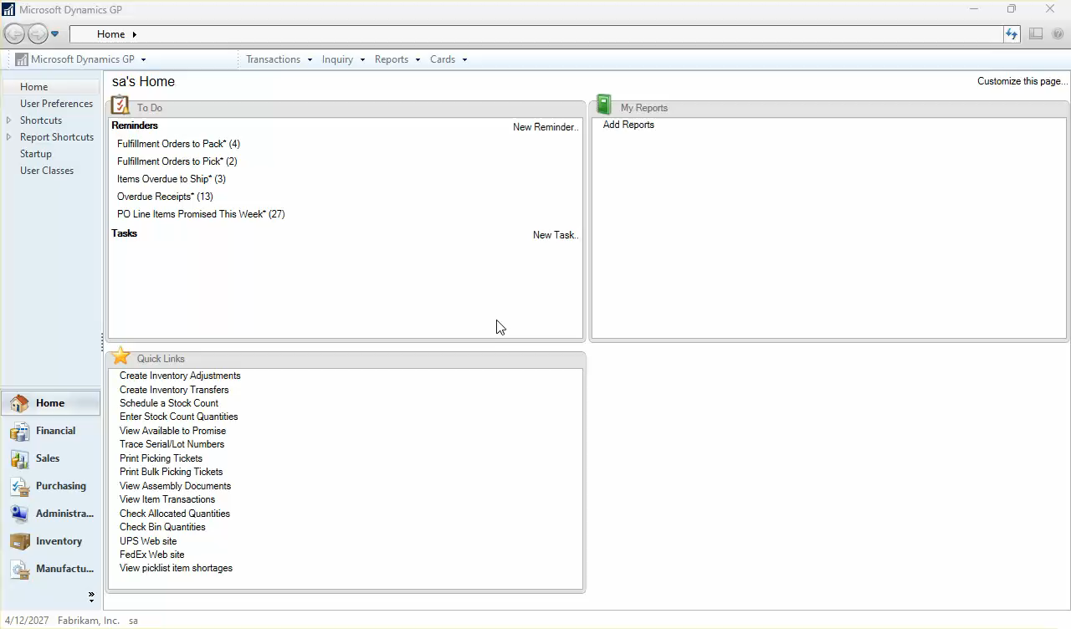

Slide 8
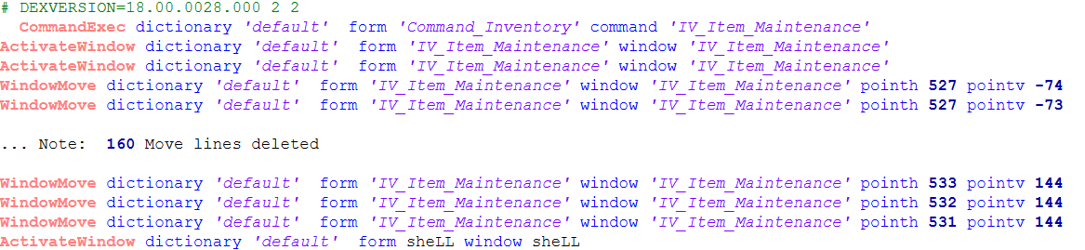
Macro Details
ActivateWindow - Clicking back on the main menu to stop recording the macro
This line is not needed
WindowMove – Move the Item Maintenance to the new horizontal and vertical position specified.
Only ONE of these lines are needed (The last one)
ActivateWindow – Make sure the Item Maintenance window is open before proceeding
Only one ActivateWindow is needed
CommandExec - from the Inventory Menu, open the Item Maintenance Window
# is a comment character
Everything to the right of the # can be ignored

Slide 9
Three version of the macro file
Original
As it was originally recorded
New
Remove the “duplicate” lines
Newest
Don’t show the “ran” dialog at the end

Slide 10
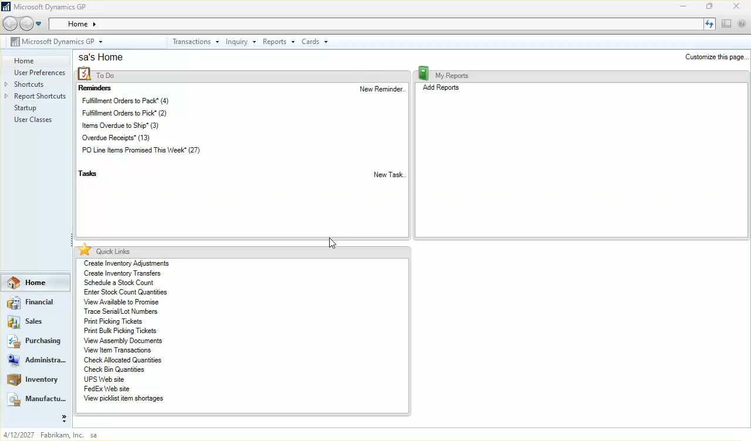

Slide 11
Final Macro
The macro edited down to required lines only
Logging file 'filename'
Must be the first executable line
Save the results of the macro to this file
Suppresses the "Macro run" dialog
Use 'nul' prevent a file from being created

Slide 12
Startup and Shortcuts
Assign macro to Startup or Shortcuts
Items in the Startup folder will run when GP starts
Keyboard shortcuts can be assigned to either
Note: The Fabrikam sample company warning
prevents macros from auto-starting

Slide 13
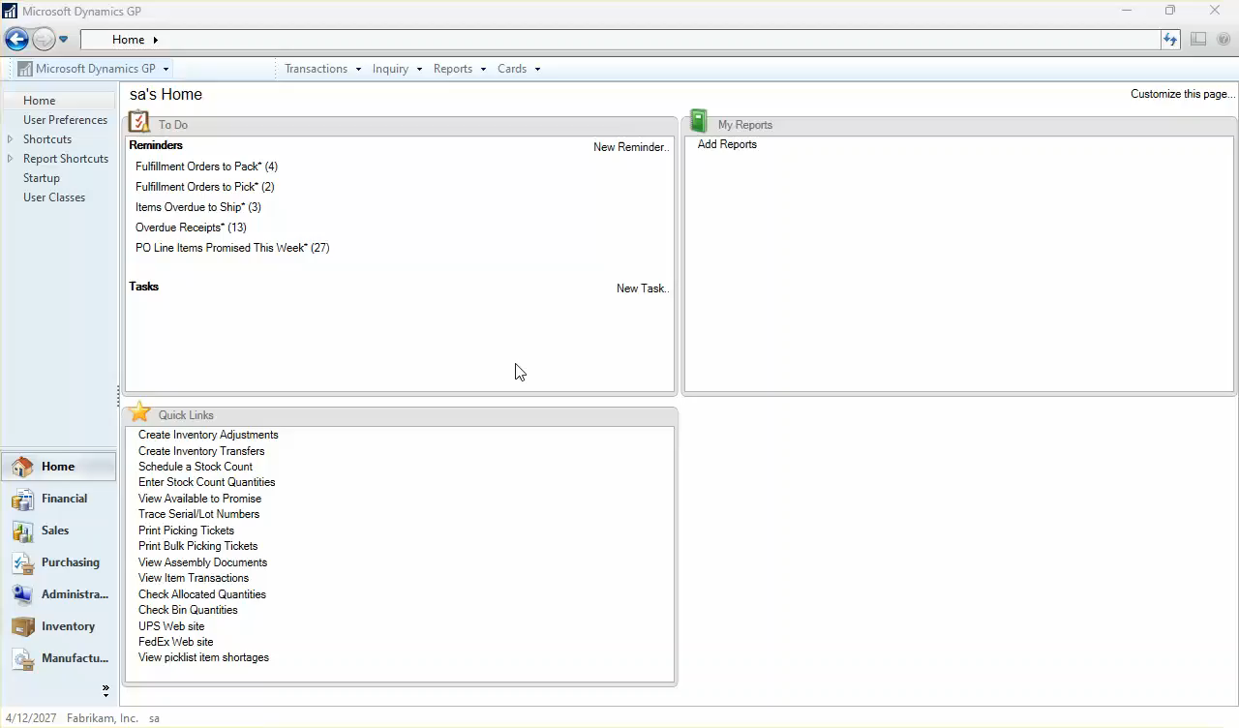

Slide 14
Editing Records
Open window to edit record
Enter record key (Item #, Customer #, Account…)
Move to and edit each field that need updating
Save Record
Go to Step 2 – Rinse and Repeat
How do we easily apply this to multiple records?

Slide 15
Replicator vs Mail Merge
Replicator and Mail Merge (MM) both combine a macro and data to produce a super-macro
MM – uses Word to do the merging – multiple apps
Word uses smart quotes (’) – breaks GP
Single quotes in the data will break GP
MM – No concept of header lines
Must save macro file as txt file from Word
Mapping of data fields is harder in MM
Easy to drive data with a query in Replicator
Filtering data is harder in MM
Replicator is FREE! (Rnoldz.com)

Slide 16
Replicator
Excel macro based (VBA) worksheet
Macro – Record macro and import into Replicator
Data
  Static data imported into Replicator
  Dynamic data from query (Excel Refreshable)
Easy to map data columns into macro fields
Replicate
Run Super-macro in GP

Slide 17
Use Case for Mass Updates
At US Digital, customers can have custom parts designed for their specific needs
Each custom part has special pricing that expires
The expiration date is stored in the 1st User Def field
A SQL query is run to set expired items to inactive
Customer Service can not sell inactive items
The pricing is reviewed and the expiration
date is reset

Slide 18
Query details
Look at all items in the Item Master table
Return the items where the expiration date (User Def 1) has been set and is less than or equal to the first of this month
Look at the item engineering card to make sure
these items are also active
Note: User Def 1 is a CHAR field. The date is
stored as YYYY-MM for sorting

Slide 19
The Custom Item Query
CREATE PROCEDURE _usd_ActiveItemsThatHaveExpired
AS
SELECT RTRIM(IV00101.ITEMNMBR) AS ItemNumber
FROM IV00101
JOIN IVR10015
ON IVR10015.ITEMNMBR = IV00101.ITEMNMBR
WHERE IVR10015.ITEMSTATUS_I = 1 -- Active
AND IV00101.USCATVLS_1 <= FORMAT(GETDATE(), 'yyyy-MM')
AND IV00101.USCATVLS_1 <> ''

Slide 20
Issues with the Notes button
A record with no notes has a tan button
'Note Absent Button - Window Area'
A record with notes has a yellow button
'Note Present Button - Window Area'
The macro must press the "correct" button
Look at SY03900 in the query to see if notes exist
Extra: include the current timestamp in the note

Slide 21
The Revised Custom Item Query
CREATE PROCEDURE _usd_ActiveItemsThatHaveExpired
AS
SELECT RTRIM(IV00101.ITEMNMBR) AS ItemNumber,
GETDATE() AS Now,
IIF(SY03900.NOTEINDX IS NULL, 0, 1) AS HasNotes
FROM IV00101
JOIN IVR10015
ON IV00101.ITEMNMBR = IVR10015.ITEMNMBR
LEFT JOIN SY03900
ON IV00101.NOTEINDX = SY03900.NOTEINDX
WHERE IVR10015.ITEMSTATUS_I = 1 -- Active
AND IV00101.USCATVLS_1 <= FORMAT(GETDATE(), 'yyyy-MM')
AND IV00101.USCATVLS_1 <> ''

Slide 22
Create the "Inactivate" Macro
Open Item Maintenance
Enter Item Number
Open and set Notes
Attach Notes
Open Item Engineering Card
Set to Inactive
Save and Close Item Engineering Card
Save Item (Note – clears window)

Slide 23
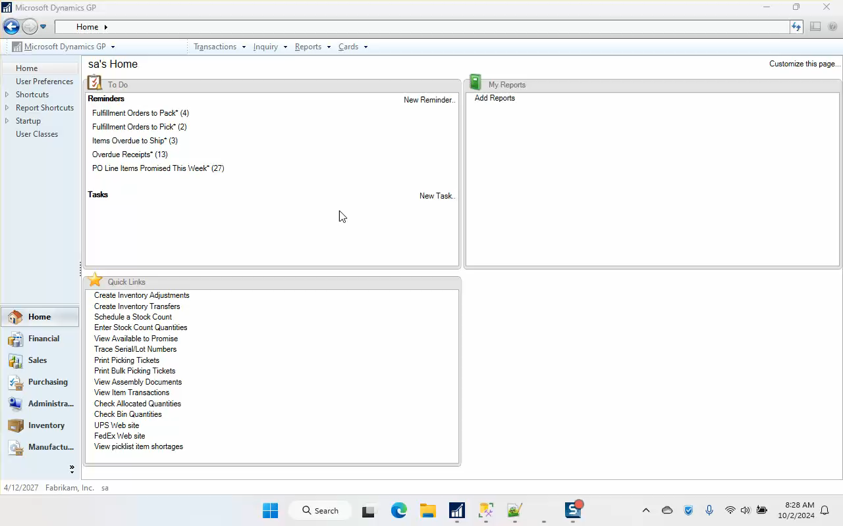

Slide 24
Setup Replicator
Download Refreshable Report Template and Replicator
Create Excel Refreshable from Stored Procedure
Open Replicator spreadsheet
"Replace DataTable" with Excel Refreshable
Add Absent/Present column to Table
Map Columns
Replicate
Run Replicated macro in GP

Slide 25
Live Demo – Replicator Setup
Enjoy my mouse movement and typing… ☺

Slide 26
Other Tips and Tricks
Data Table Name – for data tables in other worksheets
Filter Column - reduce your macro for testing
Max {RecordNumber} – for scrolling windows
Add formulas to DataTable for extra data
  =TEXT(Data, Format) to format numbers
  =TEXT(Data, "0.00") to make sure there is a decimal entered
  correctly and with the correct # of zeros after the “.”

Slide 27
Macro Limitations and Warnings
There is no Undo! Test, test, test!!!
Don't touch the keyboard or click the mouse
Clicking check box turns it on or off
Picking items from Lists can be difficult
There is no program control
  No "if" statements
  No "looping" statements
Changing items on the Print window

Slide 28
Suggested Resources
Rnoldz.com
  Replicator
  GP Macro Notepad++ XML file
  Refreshable Report Template
  Query String Finder
Notepad++ - link to text editor
Learn about security from yesterday's "Stop exporting your SmartLists to Excel! Create Refreshable Reports instead!“

Slide 29
Thank you for attending!
Questions???
John Arnold
John_P_Arnold@hotmail.com

